Slide 1
A Study of Malware on the Gnutella Network using LimeWire
Fall 2008: Integrated Research Component
Computer Science 352: Computer Security
Professor: Oberta Slotterbeck
By: Matthew Young

Slide 2
Project Description - Overview
Create a program that will download sample data from the Gnutella network with varying file sizes and file types using a number of different queries.
Scan this sample data for malware. Scanning the files based on the queries used and the type of file.
Analyze the results of the scans and drawing conclusions based on these results.

Slide 3
Why this Project?
Peer-to-Peer (P2P) file sharing is a rapidly growing area where new users often do not completely understand the risks they are taking.
As a user of P2P file sharing programs it was interesting to see the types of files being shared and how much malware there was on these networks.

Slide 4
Why LimeWire?
LimeWire is free and open-source.
LimeWire is the most popular P2P and file-sharing program with over 160 million downloads.
LimeWire is a Peer-to-Peer client that uses the Gnutella network to find and share files.

Slide 5
The Gnutella Network
The decentralized model of the Gnutella Network uses every client as both a client and a server.
Called “servents”, they perform both client and server like tasks.
They can provide client-side interfaces where queries can be issued and results viewed, while also performing server-like tasks such as accepting queries from other servernts, checking for matches, and responding with the results.
Because of its distributed nature the network is very fault-tolerant.

Slide 6
The Gnutella Network Continued
All of the servents are not equal however. The network is made up of leaf nodes, and ultra nodes (or ultrapeers).
Each leaf node can connect up to three ultra nodes which are connected to over 32 other ultra nodes.
Ultrapeer’s are responsibility for all of the routing in the network.
Leaf nodes that are capable of handling routing messages and queries are promoted to ultra nodes.

Slide 7
Gathering the Data
There were several constants decided on before any files were downloaded.
25 different keywords.
30 files for each query.
Any file type between 1 and 5,000 KB’s.
Along with the files themselves, the runtimes and the total number of search results were also saved after each search.

Slide 8
Keywords
Keywords were picked to fit one of four broader categories.
  Movies
  Music
  Software and OS’s
  Video Games
Movies, Music and Video Games each had five keyword’s, while Software and OS’s had ten.
Keywords were chosen based on a number of different criteria. Recent and popular movies, music, and video games were used, and software keywords were chosen from CNET’s most popular Windows downloads list.

Slide 9
Keyword List
Movies
Indiana Jones
Iron Man
Quantum of Solace
The Dark Knight
WALL-E
Music
AC/DC
Coldplay
Lil Wayne
Metallica
Rihanna
Video Games
Call of Duty
Dead Space
Fallout
The Sims
Warcraft
Software – OS’s
Adobe AVG LimeWire Linux
Mcafee MSN Office OSX
Windows WinZip

Slide 10
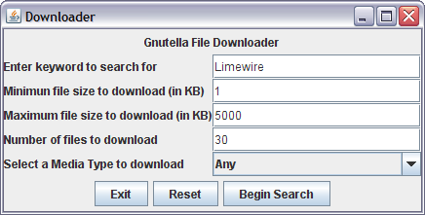
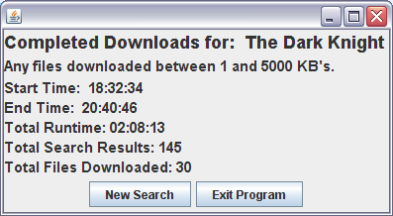
Gathering Data – The Downloader
The Downloader allows the user to input Keyword, minimum and maximum file sizes, the number of and type of files to be downloaded.
After beginning the search, the downloader will automatically download the files, and once complete, display the results.

Slide 11
Gathering Data - Problems
The systems anti-virus software detected viruses in several executable files as they were downloaded.
The downloader had to be stopped on a couple of occasions after some very questionable files were found.

Slide 12
Gathering Data - Results
Total of 750 files downloaded from the 1900 search results.
The total runtime for the downloader was 22 hours, 20 minuets, and 3 seconds.
The 750 files took up a total of 778 MB, with 254 Audio/Video files, 430 Zipped files, and 66 Others ranging from JPEG’s to Torrent files.

Slide 13
Analyzing the Data
Both AVG Free and Kaspersky’s free online virus scanner were used to scan the data.
AVG Free found more infections overall, but it also would count the same threat more then once for some files, and some files were counted as multiple “objects”.
AVG Free also deleted the infections once found.
Because multiple scans of the same files were needed, and because Kaspersky would only return “one” infection per file, these are the results used.

Slide 14
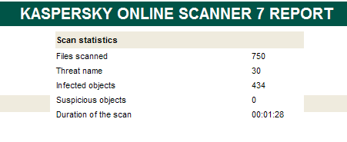
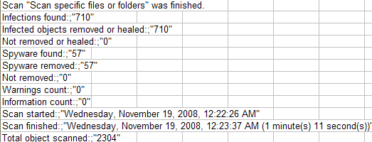
AVG Free Vs. Kaspersky
Total results using the Kaspersky Online Scanner.
Overall results using the AVG Free Anti-Virus scanner.

Slide 15
Analyzing the Data – By File Type
Of the 750 files that were downloaded, 434 or 58% contained an infection of some type.
There were a total of 30 different threats.
Of these, 396 (91%) of the infections were from Zipped files, with the remaining 38 (9%) of infections being found in Audio/Video files.
The “Others” file type contained no malware.

Slide 16
Analyzing the Data - By Query Type
255 or 59% of infected files came from the Software and OS’s queries.
100 or 23% of infected files came from Movie queries.
72 or 16% of infected files came from Video Game queries.
7 or 2% of infected files came from Music queries.

Slide 17
Infections Found
Trojan-Downloader.WMA.GetCodec.b
Trojan-Downloader.Win32.VB.bsa
Trojan.Win32.Buzus.adbl
P2P-Worm.Win32.VB.dw
Virus.Win32.Sality.v
AdWare.Win32.Agent.dva
Trojan.Win32.Agent.uvi
Trojan-Dropper.Win32.VB.gtf
Backdoor.Win32.IRCBot.dd
Trojan.Win32.VB.eme
Virus.Win32.Fontra.c
P2P-Worm.Win32.Agent.bm
Trojan.Win32.Obfuscated.gen
Trojan-Downloader.Win32.VB.dck
Trojan-Downloader.Win32.VB.dck was by far the most common infection found, making up over 50% of the total.

Slide 18
Conclusions
Zipped files are the most likely to contain malware, with 396 of the 430 files downloaded being infected (92%).
While no queries were completely safe, Music searches resulted in the least amount of malware with only 7 of the 150 downloaded files being infected (5%).
Audio and Video files are not immune to infection, 38 of the 254 Audio/Video files downloaded were infected (15%).

Slide 19
Conclusions Continued
Of the 66 “Other” file types downloaded, there were no infections found in any.
Queries for Software or OS’s were the most likely to return an infected file, with 255 of the 300 files downloaded being infected (85%).
Do not download 113KB Zip files. 223 of the 224 files this size contained the Trojan-Downloader.Win32.VB.dck (99.5%).

Slide 20
Overall Evaluation of Project
Overall the project was a success. The downloader worked as expected with only minor errors and malfunctions.
The analysis of data went faster then expected and the number of infected files were higher then anticipated.
Surprisingly there were no system crashing viruses infecting the system during any phase of the project.

Slide 21
If today was day one?
Get started with the data collection sooner.
Multitask and download sample data while working on the graphical user interface.
Don’t assume that P2P traffic will always work when it’s needed, and be prepared for unexpected network problems.

Slide 22
Future Research
Integrate an anti-virus scanner into the program to completely automate the process.
Analyze a larger sampling of data, with more keyword categories and more queries.
Investigate the infections that were found and evaluate the threats they pose.
Research ways to filter and block files that contain malware before they are downloaded.

Slide 23
References
CNET’s most downloaded Window’s Software www.download.com/most-popular-software
Billboard’s Top 200 Album Sales www.billboard.com/bbcom/charts/chart_display.jsp?g=Albums&f=The+Billboard+200
Kaspersky Lab’s Virus Scanner www.kaspersky.com/virusscanner

Slide 24
References Continued
Gnutella Network Background Information http://wiki.limewire.org/index.php?title=Background
Yahoo Movies Top Movies by Cumulative Gross movies.yahoo.com/mv/boxoffice/weekend/bycgross

Slide 25
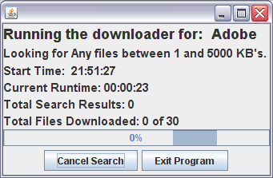
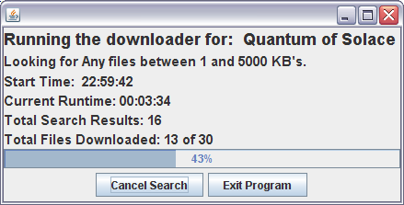
In Case of Emergency

